Slide 1

Has ODYSSEY changed the Odyssey of Vulnerable Plaque?
Dr. Ankita Kulkarni
Assistant Professor
Department of Cardiology
Seth GSMC and KEMH
Role of medical management for treatment of vulnerable plaque

Slide 2
Initiation & progression
Plaque begins with endothelial dysfunction
Increased permeability to lipoproteins
Recruitment of inflammatory cells to form foam cells
Vascular smooth muscle cell proliferation
Fibrous cap formation
An established atherosclerotic plaque.
May be interrupted by acute events leading to ACS

Slide 3
Stable
Unstable

Slide 4
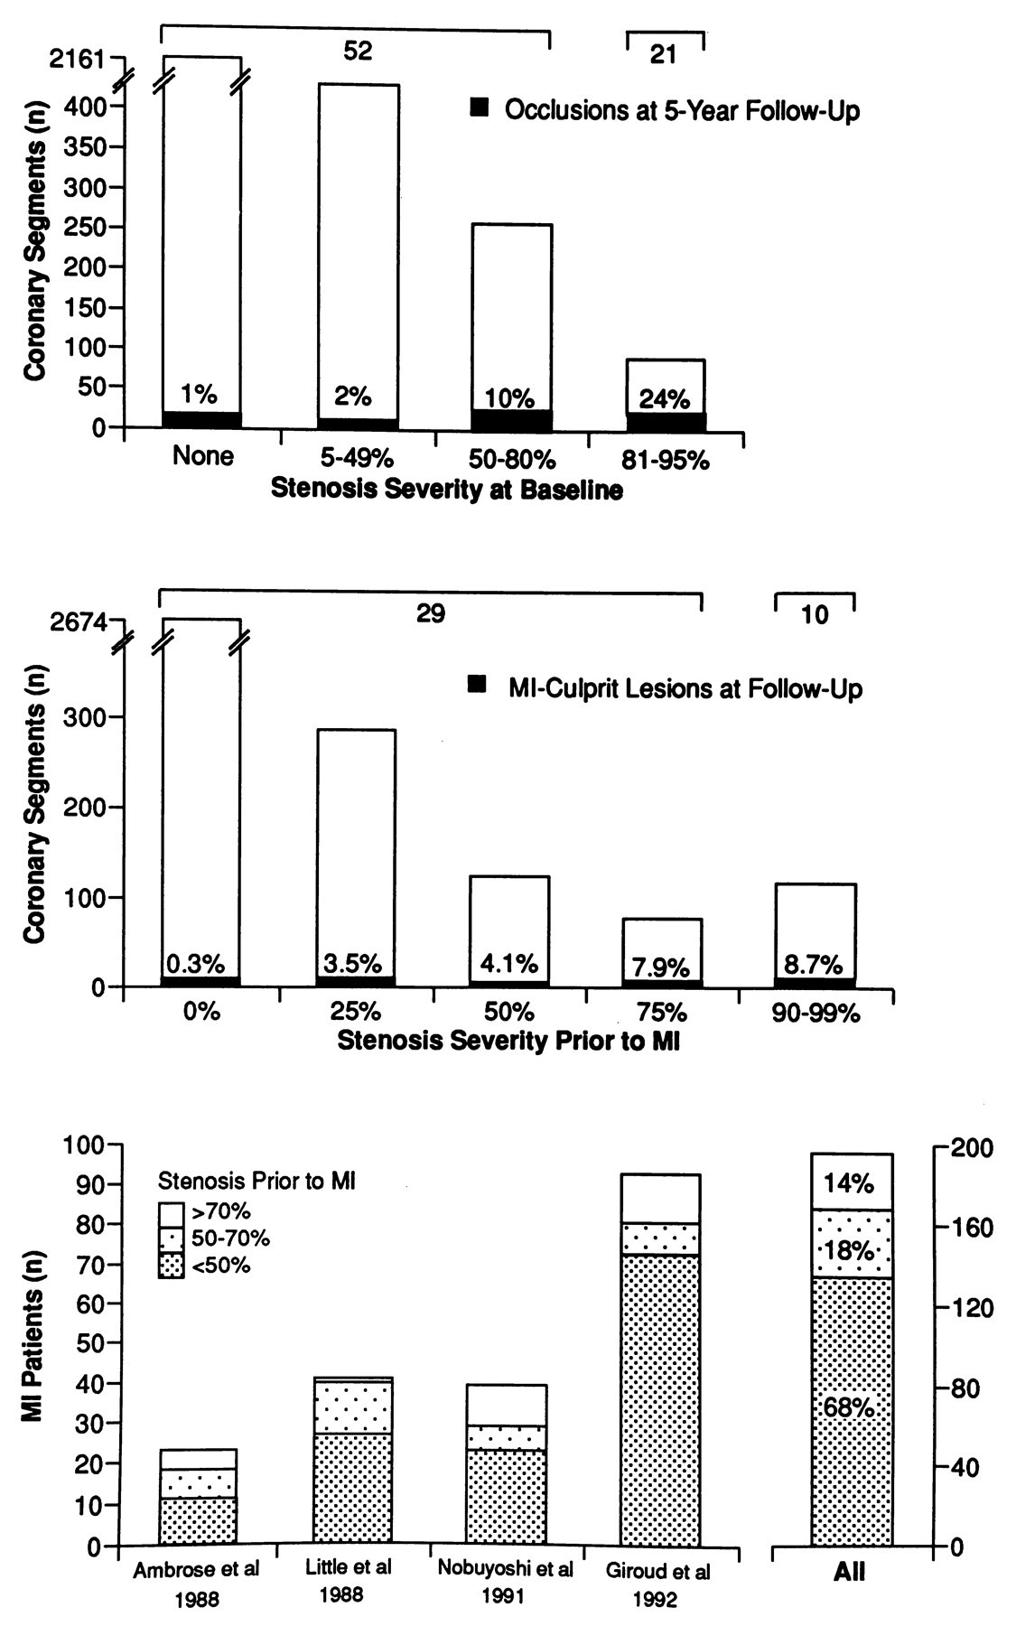
Bar graphs showing stenosis severity and associated risk of coronary occlusion and myocardial infarction (MI) as evaluated by serial angiographic examination.
The more stenotic an individual coronary segment is at baseline, the more frequently it progresses to occlusion (top) and/or gives rise to infarction (middle).
Because less-obstructive plaques by far outnumber severely obstructive plaques, most occlusions and infarctions result from progression of the former plaques (52 vs 21 and 29 vs 10, respectively), ie, MI evolves most frequently from plaques that are only mildly to moderately obstructive months to years before infarction (bottom)

Slide 5
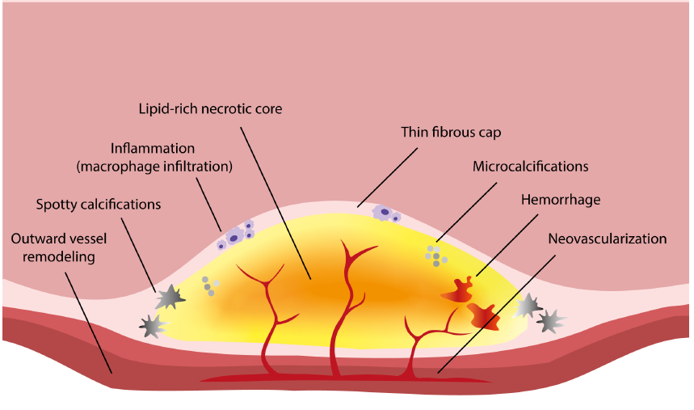
The vulnerability of an atheromatous plaque is defined by
(1) size and consistency of the atheromatous core,
(2) thickness and collagen content of the fibrous cap covering the core,
(3) inflammation within the cap, and
(4) cap “fatigue.”
(5) Presence of calcium nodules

Slide 6
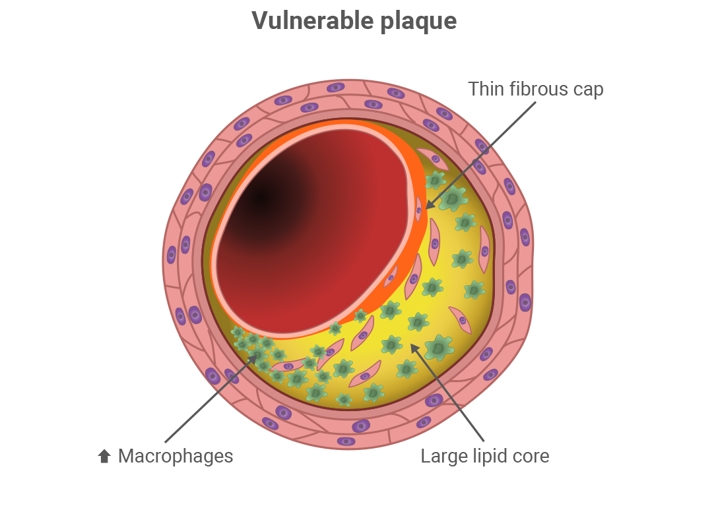
Defining the vulnerable plaque

Slide 7
Imaging
Invasive
CAG
IVUS
Non-invasive
CCTA
PET-CT
OCT

Slide 9
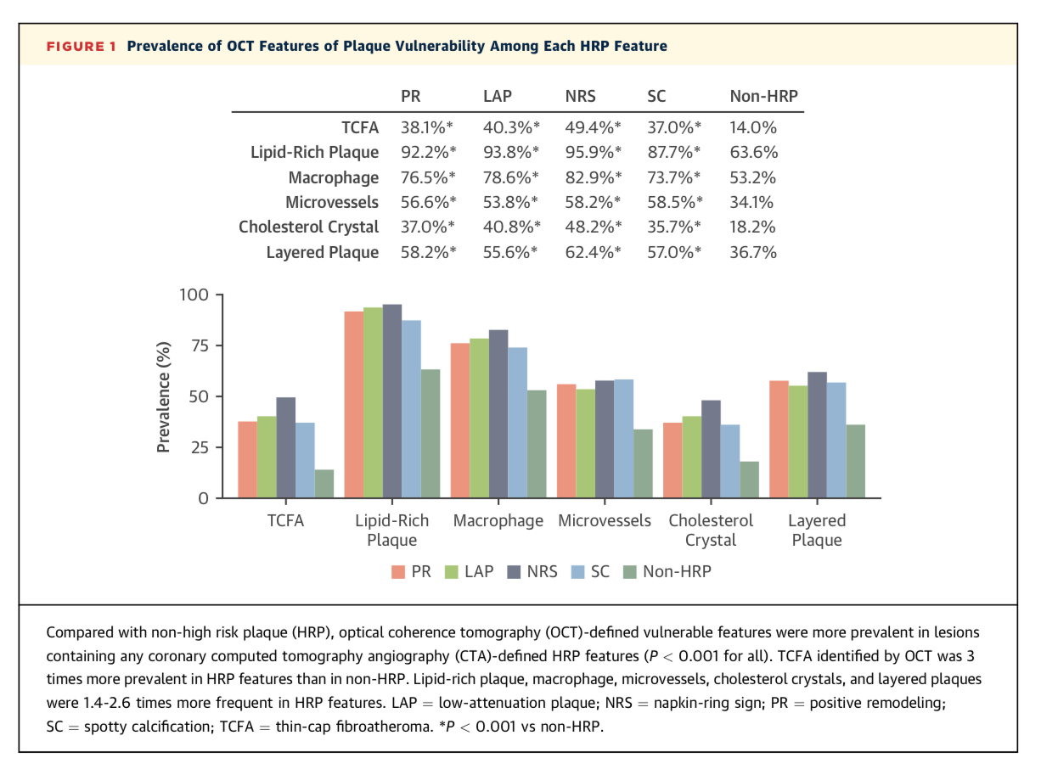

Slide 10
Plaque regression
lipid content
macrophage content and
inflammatory state
Traditionally, defined as increase in luminal diameter on CAG
Lately considers both plaque volume and composition

Slide 11
Plaque Regression Strategies

Slide 12
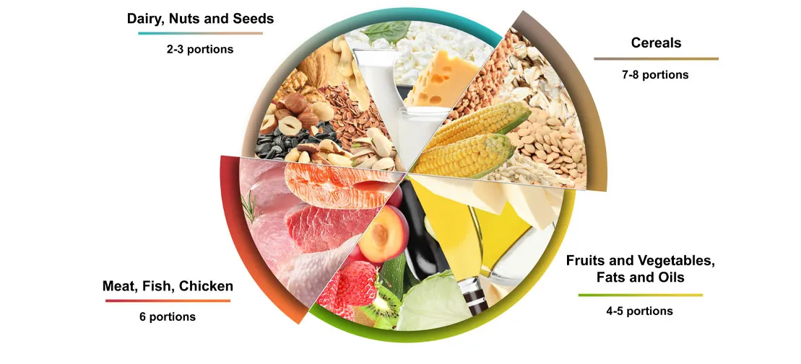
Diet
Major role in CV risk through both excess caloric intake and specific dietary patterns
Plaque regression not well documented
2 studies in the past
Ornish et al (1998) and DISCO-CT trial
Each randomizes 48 and 92 patients respectively
Demonstrated plaque regression through CAG and CCTA
Recent evidence in the form of placebo arm of statin trials showed progression of atheroma
Diet strategy alone ?? Doubtful role

Slide 13

Exercise
Both primary and secondary prevention of CV events.
A recent Cochrane review and meta-analysis including 63 studies found that exercise-based cardiac rehabilitation led to a 26% reduction in CV mortality.
Two RCTs showed no significant plaque regression
Post-hoc analysis pointed to greater regression in patients walking >7000 steps/day.
Cross-sectional studies -assessing plaque composition among athletes -higher calcific plaque volume in athletes
whereas sedentary participants had greater mixed plaque morphologies, at higher risk for coronary events.
Overall- Modest benefit.

Slide 14

Smoking and Alcohol
Smoking has clear documented role in plaque progression.
IVUS studies showed higher necrotic core volumes, coronary plaque burden, and fibro-fatty volume with lower fibrous plaque volume
Similar cross sectional studies for alcohol showing inverse relationship between alcohol intake and coronary calcification

Slide 15
Pharmacological

Slide 16
Statins
Have formed the backbone of lipid management since early 1990s
Their impact on plaque regression well studied
Can induce plaque regression, reducing total atheroma volume (TAV) somewhere in the vicinity of 0%-20%
ASTEROID (A Study to Evaluate the Effect of Rosuvastatin On Intravascular Ultrasound Derived Coronary Atheroma Burden) study in 2006, - Observational
Others COSMOS and IBIS-4 demonstrated significant reductions in TAV with rosuva 40mg

Slide 17
High vs low dose statins
REVERSAL, SATURN and JAPAN-ACS
A large body of evidence suggests that statins induce plaque regression in a dose-dependent manner and proportionally to reductions in LDL-C.
In response to statins, fibrous and calcified plaque vol- umes appear to increase, whereas noncalcified, fibrofatty, and necrotic core volumes decrease.

Slide 18
Ezetimibe
HEAVEN (Virtual Histology Evaluation of Atherosclerosis Regression During Atorvastatin and Ezetimibe Administration) (2012),
ZEUS (eZEtimibe Ultra- sound Study) (2014),
PRECISE-IVUS (Plaque Regression With Cholesterol Absorption Inhibitor or Synthesis Inhibitor Evaluated by Intravascular Ultra- sound) (2015),
OCTIVUS (Ezetimibe In Addition To Atorvastatin Therapy On The Plaque Composition in Patients with Acute Myocardial Infarction) (2016), and
ZIPANGU (ezetimibe clinical investigation for regression of intracoronary plaque evaluated by angioscopy and ultrasound) (2017)
Most of these studies demonstrated significant plaque regression among patients taking ezetimibe ranging from 2.9% to 13.9%
Although the use of ezetimibe to reduce LDL-C and major adverse cardiovascular events (MACE) is well evidenced, the benefits with regards to inducing plaque regression appear to be small.

Slide 20
PCSK 9 Inhibitors
PCSK9 works to reduce hepatocyte low-density lipoprotein (LDL) receptors, interfering with LDL clearance from plasma.
2016 GLASGOV trial - randomized 968 patients to evolocumab or OMT and used IVUS - After 76 weeks, showed greater reductions in total atheroma volume with evolocumab
The 2019 ODYSSEY J-IVUS - evaluated the efficacy of alirocumab 75 mg in 206 patients with recent ACS against OMT using IVUS – showed reductions in total atheroma volume but not statistically significant
PCSK9 inhibitors also lower lipoprotein(a) by around 25%, which may mediate some of the benefits seen on plaque volumes
Evolocumab and alirocumab

Slide 21
Eicosapentaenoic Acid
They act as precursors for important inflammatory mediators that stabilize endothelial dysfunction
Data regarding the impact of EPA on total atheroma volumes are mixed
1 IVUS randomized controlled trial (RCT) CHERRY [Combination therapy of eicosapentaenoic acid and pitavastatin for coronary plaque regression evaluated by integrated backscatter intravascular ultrasonography] demonstrating greater regression over 6 months
2 other RCTs (1 IVUS, 1 CCTA) showing no significant differences
The EVAPORATE (Effect of Vascepa on Improving Coronary Atherosclerosis in People With High Triglycerides Taking Statin Therapy) trial (2020) used CCTA to assess plaque regression. Problem with control receiving mineral oil and baseline differences.
EPA-based treatments are yet to see widespread integration into clinical practice

Slide 22
Other medications
Anti-hypertensives
Colchicine
Anti-diabetic medications
LDL-apheresis

Slide 23
Discussion
Numerous studies have demonstrated that achieving lower LDL-C levels is associated with lower rates of major adverse CV events.
Similarly, the degree to which treatments lower LDL-C appears to correlate with the degree of plaque regression.
However, data assessing whether plaque regression is associated with reduced cardiovascular events are limited.
a recent meta-regression analysis of 17 prospective studies, which found each 1% reduction in percent atheroma volume was associated with a 20% reduction in odds of MACE.

Slide 25
DISCUSSION
Plaque Regression with LLT: The meta-analysis found significant regression of both percent atheroma volume (PAV) and total atheroma volume (TAV) with lipid-lowering therapy (LLT).
Effectiveness of High-Intensity Statins (HIS): Plaque regression was commonly observed in HIS subgroups, indicating the effectiveness of high-intensity statins in reducing plaque burden.
Association with LDL-C Levels: Both LDL-C levels of <70 mg/dl and ≥70 mg/dl at follow-up were associated with a greater reduction in coronary plaque volume, highlighting the importance of achieving low LDL-C levels in managing cardiovascular risk.
Impact on Plaque Volume and Fibrous Cap Thickness (FCT): LLT significantly reduced plaque volume and lipid arc while increasing FCT, emphasizing its role in stabilizing coronary plaques.
Role of Specific LLT Subgroups: HIS emerged as particularly effective in reducing TAV, surpassing other LLT classes even when combined with adjunctive therapies like ezetimibe. Additionally, PCSK9 inhibitors and EPA were found to reduce PAV, supporting their potential in plaque regression.
Clinical Implications: The findings have implications for clinical practice, aligning with AHA/ACC guidelines recommending LDL levels below 70 mg/dl to reduce cardiovascular risk.
Study Comparisons: The study results were compared with previous meta-analyses and trials such as IBIS-4, SATURN, GLAGOV, CHERRY, and EVAPORATE, providing context and validation for the current finding

Slide 26
CONCLUSION
The significant plaque regression associated with lipid lowering therapies is observed to be mainly driven by high-intensity statins, when comparing different classes of LLTs.
LLTs also significantly reduced plaque volume and lipid arc while increasing fibrous cap thickness.
Further studies are needed to determine the effects of plaque regression and content modification on MACE events.

Slide 27
Thank you!!

