Slide 1
PREVENT
Preventive PCI versus Medical Therapy Alone
for Treatment of Vulnerable Atherosclerotic Coronary Plaques
Dr Tabassum khan
Interventional cardiologist
Mumbai

Slide 2

Background
Intracoronary imaging defined vulnerable plaque (VP) has more tendency to increase major adverse cardiac events.
Optimal medical therapy (OMT) is the standard approach to stabilise plaque vulnerability.
The safety and effectiveness of focal preventive percutaneous coronary intervention (PCI) of non-flow limiting VP are unknown.
Stone GW et al. N Engl J Med 2011; 364: 226–35. Erlinge D et al. Lancet 2021; 397: 985–95.
Stone GW et al. J Am Coll Cardiol 2020; 76: 2289–301. Gaba P et al. Nat Rev Cardiol 2023; 20: 181–96. Kedhi E et al. Eur Heart J 2021; 42: 4671–79. Mol JQ et al. JAMA Cardiol 2023; 8: 1013–21.

Slide 3
Objective
PREVENT
To assess whether focal preventive PCI of non-flow-limiting, imaging defined vulnerable plaques improves clinical outcomes compared with OMT alone.

Slide 4
Trial Design
PREVENT
Coronary Stenosis (>50%) with Negative FFR (≥ 0.80) and meeting two of the following (Imaging defined VP)
MLA ≤4.0mm2
Plaque Burden >70%
TCFA by OCT or RF-IVUS
Lipid-Rich Plaque by NIRS (maxLCBI4mm>315)
Preventive PCI + OMT
N=800
OMT alone
N=800
Primary endpoint : Target Vessel Failure at 2 years
(composite of death from cardiac cause, target-vessel MI, ischemic-driven target vessel revascularization, or unplanned hospitalization
due to unstable or progressive angina)

Slide 5
Major Inclusion Criteria
PREVENT
Men or women at least age ≥ 18 years.
Patients with angiographically significant stenosis (>50%) with negative FFR (>0.80) and meeting two of the following,
  MLA < 4mm2
  Plaque burden >70%
  TCFA detected by RF-IVUS or OCT
  Large lipid-rich plaque on NIRS (maxLCBI4mm >315)
Eligible for PCI with Absorb BVS or EES
Reference vessel diameter 2.75 – 4.0 mm
Lesion length ≤40 mm
BVS, bioresorbable vascular scaffold; CABG, coronary artery bypass grafting; CAD, coronary artery disease; EES, everolimus-eluting stent; FFR, fractional flow reserve; maxLCBI4mm, maximal lipid core burden index in a 4 mm segment; NIRS, near-infrared spectroscopy; OCT, optical coherence tomography; RF-IVUS, radiofrequency intravascular ultrasonography; TCFA, thin-cap fibroatheroma. TCFA was defined as a ≥10% confluent necrotic core with >30° abutting the lumen in 3 consecutive frames on RF-IVUS or a lipid plaque with arc >90° and fibrous cap thickness <65 μm on OCT.

Slide 6
Major Exclusion Criteria
PREVENT
Patients in whom the preferred treatment is CABG.
Previously stented lesion
Bypass graft lesion
Patients with 3 or more target lesions
Patients with 2 target lesions in the same coronary artery
Heavily calcified or angulated lesion
Bifurcation lesion requiring 2-stent technique
Contraindication to or planned discontinuation of dual antiplatelet therapy within 1 year

Slide 7
Procedure
PREVENT
During the initial recruitment period of the trial, PCI was performed with BVS (Absorb; Abbott). Following the withdrawal of BVS, cobalt-chromium everolimus-eluting metallic stents (Xience; Abbott) were used for the default device of PCI.
Intravascular imaging of all target lesions was performed.
Patients received dual antiplatelet therapy for at least 6 or 12 months after PCI according to clinical presentation and anatomical complexity.
Clinical follow-up was done at 1, 6, 12, and 24 months and every year thereafter. Follow- up continued annually in all enrolled patients until the last enrolled patient reached 2 years after randomization.

Slide 8
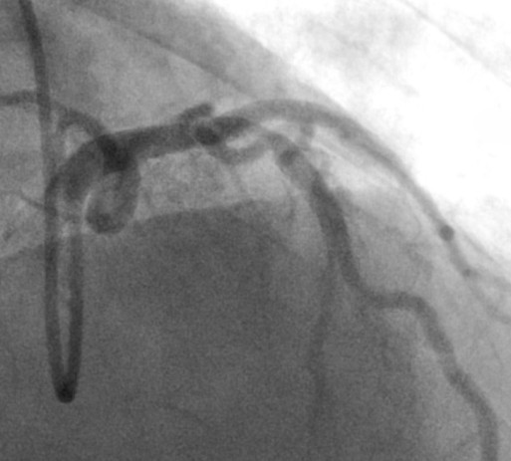
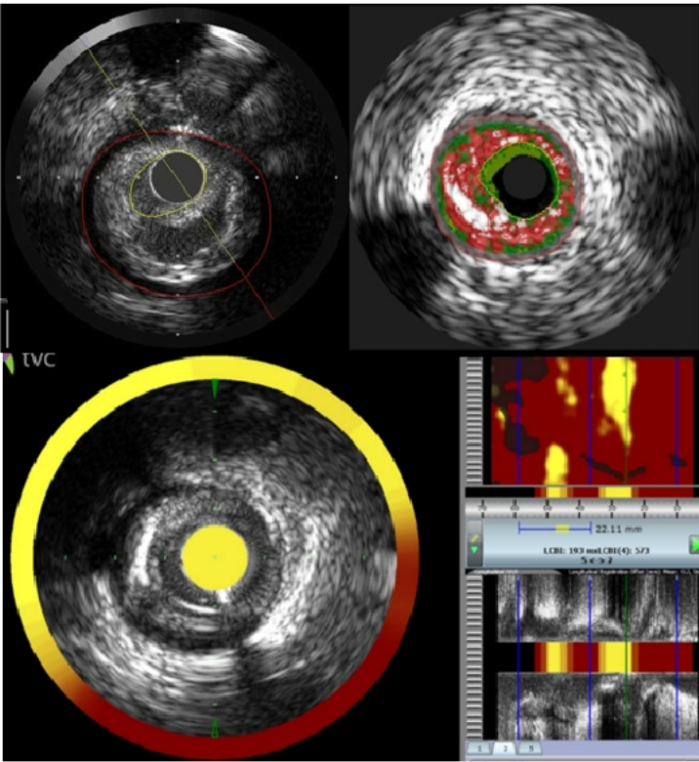
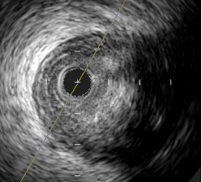
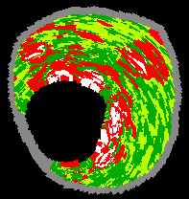
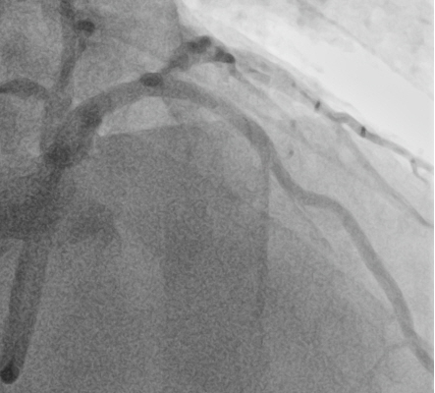
Procedure
PREVENT
Diameter stenosis 70%,
FFR 0.83
MLA 2.11 mm2
Plaque burden 79% TCFA by RF-IVUS
maxLCBI4mm 573
Absorb (BVS)
3.5 mm x 18 mm

Slide 9
Primary Endpoint
PREVENT
Target Vessel Failure (a composite of death from cardiac causes, target vessel myocardial infarction, ischemia-driven target-vessel revascularization, or hospitalization for unstable or progressive angina) at 2 years after randomization

Slide 10
Secondary Endpoint
PREVENT
Individual components of the primary composite outcome
Patient-oriented composite of all-cause death, all myocardial infarctions, or any repeat revascularization
Procedural safety outcomes
Stroke
Bleeding events
Number of anti-anginal medications used at each time point

Slide 11
PREVENT
Statistical Considerations
Power Calculation (N = 1,600)
Assuming an incidence of the primary outcome at 2-years of 8.5% for preventive PCI group and 12.0% for OMT alone group (30% relative risk reduction),
A sample size of 1600 patients provided 80% power at a two-sided significance level of 5%, assuming a 7% loss to follow-up and crossover rate.
Pre-Specified Statistical Analysis
Primary intention-to-treat analysis
Time-to-first-event estimate with Kaplan–Meier methodology
Cox proportional hazard models to estimate the treatment effects
Sensitivity analyses in the per-protocol and as-treated populations
Absolute differences and 95% confidence intervals calculated at 2 years (primary outcome), 4 years (median follow-up), and 7 years (maximum follow-up)

Slide 12
PREVENT
Patient Flow and Follow Up
5627 patients
with intermediate stenosis (DS >50%)
from Sep 23, 2015,
through Sep 29, 2021
2065 with revascularization with positive FFR (<0.80)
63%
3562 with lesions with DS >50% and negative FFR (>0·80)
1954 not meeting imaging criteria of vulnerable plaque excluded
45%
1608 randomly assigned Imaging criteria of vulnerable plaque
Preventive PCI plus OMT (803)
OMT alone (803)

Slide 13
PREVENT
Patient Flow and Follow Up
1606 patients with
Imaging criteria of vulnerable plaque
Preventive PCI plus OMT (803)
OMT alone (803)
6 Withdrew consent at <12 mo
17 Were lost to follow-up at <12 mo 74 crossed over to OMT alone
2 Withdrew consent
25 Were lost to follow-up
12 crossed over to preventive PCI plus OMT
780 (97.1%) completed 2-year follow-up
776 (96.6%) completed 2-year follow-up
762 (94.9%) completed final follow-up
743 (92.5%) completed final follow-up
803 (100%) included
in the intention-to-treat analysis
803 (100%) included
in the intention-to-treat analysis

Slide 14
Baseline Characteristics
PREVENT
 |  | Preventive PCI plus OMT (N=803) | OMT alone (N=803)
Age — years |  | 64 (58 – 71) | 65 (59 – 71)
Female sex |  | 197 (25%) | 232 (29%)
Body-mass index — | kg/m² | 24.6 (22.9 – 26.5) | 24.7 (22.9 – 26.4)
Diabetes mellitus — no. (%) |  | 244 (30%) | 246 (31%)
Hypertension — no. (%) |  | 519 (65%) | 536 (67%)
Dyslipidemia — no. (%) |  | 721 (90%) | 709 (88%)
Current smoking — no. (%) |  | 136 (17%) | 139 (17%)
Previous PCI — no. (%) |  | 109 (14%) | 85 (11%)
History of cerebrovascular disease — no. (%) |  | 52 (6%) | 50 (6%)
Left ventricular ejection fraction [%], (N=843)† |  | 63 (60 – 66) | 63 (60 – 66)
Clinical presentation — no. (%)
Stable angina or silent ischemia |  | 670 (83%) | 677 (84%)
Unstable angina |  | 106 (13%) | 91 (11%)
Non-ST elevation myocardial infarction |  | 18 (2%) | 28 (3%)
ST-elevation myocardial infarction |  | 9 (1%) | 7 (1%)
Data are median (inter-quartile range), or n (%). †Preventive percutaneous coronary intervention group n=485; optimal medical therapy group n=358.

Slide 15
Anatomic Characteristics
PREVENT
 | Preventive PCI plus OMT (N=831) | OMT alone (N=841)
Qualifying criteria for target lesions† | N=831 | N=841
MLA <4.0 mm² by gray-scale IVUS or OCT | 809 / 831 (97%) | 817 / 841 (97%)
Plaque burden >70% by gray-scale IVUS | 792 / 815 (97%) | 805 / 831 (97%)
Large lipid-rich plaque by NIRS (maxLCBI_{4mm}>315) | 99 / 348 (28%) | 94 / 369 (26%)
TCFA defined by OCT or radiofrequency IVUS | 39 / 571 (7%) | 40 / 679 (6%)
Target lesion location
Left anterior descending artery | 416 (50%) | 400 (48%)
Left circumflex artery | 170 (20%) | 147 (17%)
Right coronary artery | 245 (29%) | 294 (35%)
Median FFR values of target lesions | 0.87 (0.83 – 0.90) | 0.86 (0.83 – 0.90)
QCA of target lesions
Diameter stenosis — % | 56.6 (9.2) | 52.6 (9.8)
Minimal lumen diameter — mm | 1.3 (0.3) | 1.5 (0.4)
Reference vessel diameter — mm | 3.1 (0.4) | 3.1 (0.5)
Lesion length — mm | 23.6 (8.5) | 19.3 (8.3)

Slide 16
Core Lab-Imaging Analysis
PREVENT
 | Preventive PCI plus OMT (N=831) | OMT alone (N=841)
IVUS measurements | N = 811 | N = 830
Lesion length — mm | 23.7 (8.7) | 22.6 (9.1)
Minimal lumen area — mm² | 2.78 (0.87) | 2.83 (0.87)
Minimal lumen area ≤4.0 mm² | 784 / 811 (97%) | 801/830 (97%)
Plaque burden — % | 75.9 (6.9) | 76.4 (4.4)
Plaque burden >70% | 718 / 809 (89%) | 753 / 829 (91%)
NIRS measurements | N = 348 | N = 369
Plaque-level maxLCBI_{4mm} > 315 | 144 (41%) | 138 (37%)
RF-IVUS measurements | N = 456 | N = 575
TCFA defined by RF-IVUS | 57 / 465 (13%) | 73 / 575 (13%)
OCT measurements | N = 63 | N = 21
TCFA defined by OCT | 11 / 63 (18%) | 7 / 21 (33%)
No· of high-risk plaque features†
Lesions with ≥2 of 4 high-risk features | 736 (89%) | 760 (90%)
Lesions with ≥3 of 4 high-risk features | 163 (20%) | 177 (21%)
Lesions with 4 of 4 high-risk features | 12 (1%) | 13 (2%)

Slide 17
Procedural Characteristics
PREVENT
 | Preventive PCI plus OMT (N=803) | OMT alone (N=803)
PCI of target lesion, per patient, any† | 729 / 803 (91%) | 12 / 803 (1%)
Drug-eluting stent implantation | 491 / 729 (67%) | 7 / 12 (58%)
Bioabsorbable scaffold implantation | 237 / 729 (33%) | 5 / 12 (42%)
Number of stents or scaffolds implanted | 1 (1 – 1) | 0 (0 – 0)
Stent or scaffold diameter — mm | 3.5 (3.0 – 3.5) | 3.25 (3.0 – 3.5)
Total stent or scaffold length — mm | 23 (18 – 28) | 23 (18 – 28)
Intravascular imaging used to optimize 729 / 729 (100%) 12 / 12 (100%) stent or scaffold implantation
PCI of non-target lesions, per patient, any | 290 / 803 (36%) | 286 / 803 (36%)
Number of lesions treated | 0 (0 – 1) | 0 (0 – 1)
Number of stents implanted | 0 (0 – 1) | 0 (0 – 1)
Stent diameter — mm | 3.25 (3.0 – 3.5) | 3.25 (3.0 – 3.5)
Total stent length — mm | 38 (23 – 51) | 38 (28 – 51)
Data are median (inter-quartile range), or n (%). †One patient underwent balloon angioplasty only.

Slide 18
Procedural Safety Outcomes : As-treated population
PREVENT
 | Preventive PCI (N=741) | OMT alone (N=865)
Patients without non-target vessel PCI | N=461 | N=569
Total PCI time — min | 29 (18 – 45) | 0
Total amount of contrast media used — mL | 150 (120 – 200) | 0
Patients with non-target vessel PCI | N=280 | N=296
Total PCI time — min | 57 (40 – 73) | 46 (25 – 65)
Total amount of contrast media used — mL | 250 (200 – 300) | 200 (150 – 250)
Preventive PCI-related acute adverse events no. (%)
Acute stent or scaffold thrombosis | 1 (<1%) | 0
Distal dissection of at least type B | 1 (<1%) | 0
Side branch occlusion | 2 (<1%) | 0
Distal embolization | 1 (<1%) | 0
Coronary perforation | 0 | 0
Data are median (inter-quartile range), or n (%).

Slide 19
Primary Composite Outcome: Target Vessel Failure at 2 Year F/U
PREVENT
10
Hazard ratio, 0.11 (95% CI, 0.03-0.36) Log-rank p=0.0003
9.4
6.5
Cumulative Incidence (%)
5
OMT Alone
3.4
Preventive PCI plus OMT
0.4
0
0
803
803
1
765
792
2
710
745
3
544
570
4
432
450
5
308
320
6
198
198
7
61
77
Years
No. at risk Alone
Preventive PCI Plus OMT

Slide 20
Primary Composite Outcome: Target Vessel Failure at 7 Year F/U
PREVENT
10
9.4
Hazard ratio, 0.54 (95% CI, 0.33-0.87) Log-rank p=0.0097
Cumulative Incidence (%)
6.5
OMT Alone
5
3.4
Preventive PCI plus OMT
0.4
0
No at risk Alone
Preventive PCI Plus OMT
0
803
803
1
765
792
2
710
745
3
544
570
4
432
450
5
308
320
6
198
198
7
61
77
Years

Slide 21
Patient-Oriented Composite Outcome: Death from Any cause, Any MI, or Any RR
PREVENT
25
Hazard ratio, 0.69 (95% CI, 0.50 to 0.95)
Log-rank p=0.022
19.3
Cumulative Incidence (%)
20
14.4
15
OMT Alone
10
5.2
5
Preventive PCI plus OMT
3.0
0
0 | 1 | 2 | 3 | 4 | 5 | 6 | 7 | Years
803 | 761 | 700 | 536 | 424 | 297 | 190 | 58
803 | 781 | 728 | 551 | 431 | 302 | 187 | 72
No. at risk Alone
Preventive PCI Plus OMT

Slide 22
Individual Components of the Primary Composite Outcome
PREVENT
Endpoints | Preventive PCI plus OMT (N=803) | OMT alone (N=803) | Difference in event rates (95% CI) | Hazard ratio (95% CI)
Primary composite outcome | 0·54 (0·33 to 0·87)
At 2 years
3 (0·4%)
27 (3·4%)
-3·0 (-4·4 to -1·8)
0·11 (0·03 to 0·36)
At 4 years
17 (2·8%)
37 (5·4%)
-2·6 (-4·7 to -0·4)
At 7 years
26 (6·5%) 47 (9·4%) -2·9 (-7·3 to 1·5)
Death from cardiac causes 0·87 (0·31 to 2·39)
At 2 years
1 (0·1%) 6 (0·8%) -0·6 (-1·3 to 0·02)
5 (0·8%) 7 (0·9%) -0·1 (-1·1 to 0·9)
At 4 years
At 7 years
7 (1·4%) 8 (1·3%) 0·1 (-1·4 to 1·5)
Target-vessel related MI
At 2 years
At 4 years
0·62 (0·20 to 1·90)
1 (0·1%)
4 (0·6%)
6 (0·8%)
7 (10%)
8 (1·4%)
-0·6 (-1·3 to 0·02)
-0·3 (-1·3 to 0·6)
-0·3 (-1·7 to 1·1)
At 7 years

Slide 23
Individual Components of the Primary Composite Outcome
PREVENT
Preventive PCI Endpoints plus OMT (N=803) | OMT alone (N=803) | Difference in event rates (95% CI) | Hazard ratio (95% CI)
Ischemia-driven target-vessel revascularization | 0·44 (0·25 to 0·77)
At 2 years At 4 years | 1 (0·1%) 10 (1·7%) | 19 (2·4%) 29 (4·4%) | -2·3 (-3·4 to -1·2) -2·7 (-4·6 to -0·8)
At 7 years | 17 (4·9%) | 38 (8·0%) | -3·2 (-7·4 to 1·1)
Hospitalization for unstable or progressive angina |  |  | 0·19 (0·06 to 0·54)
At 2 years | 1 (0·1%) | 12 (1·5%) | -1·4 (-2·3 to -0·5)
At 4 years | 4 (0·7%) | 16 (2·4%) | -1·7 (-3·0 to -0·4)
At 7 years | 4 (0·7%) | 21 (4·9%) | -4·2 (-7·17 to -1·4)

Slide 24
Secondary Endpoint Outcomes
PREVENT
Endpoints | Preventive PCI plus OMT (N=803) | OMT alone (N=803) | Difference in event rates (95% CI) | Hazard ratio (95% CI)
Death from any cause | 0·61 (0·35 to 1·06)
At 2 years
4 (0·5%)
10 (1·3%)
-0·8 (-1·7 to 0·2)
At 4 years
11 (1·8%)
17 (2·6%)
-0·8 (-2·4 to 0·8)
At 7 years
20 (5·2%)
32 (7·4%)
-2·3 (-6·0 to 1·5)
Non-target-vessel myocardial infarction
0·91 (0·39 to 2·15)
At 2 years
8 (1.0%)
12 (1·5%)
0·1 (-0·8 to 1·1)
At 4 years
10 (1.3%)
8 (1.1%)
0·3 (-0·9 to 1·4)
At 7 years
10 (1.3%)
11 (2.2%)
-0·9 (-2·6 to 0·8)
Non-target-vessel revascularization
At 2 years
At 4 years
At 7 years
0·88 (0·51 to 1·52)
13 (1·6%)
22 (3·1%)
24 (4·8%)
13 (1·7%)
19 (2·7%)
27 (5·6%)
-2·2 (-4·1 to -0·2)
-1·8 (-4·7 to 1·2)
-4·9 (-10·8 to 1·1)

Slide 25
Secondary Endpoint Outcomes
PREVENT
Endpoints | Preventive PCI plus OMT (N=803) | OMT alone (N=803) | Difference in event rates (95% CI) | Hazard ratio (95% CI)
Definite stent or scaffold thrombosis | 0·66 (0·11 to 3·95)
At 2 years
1 (0.1%)
3 (0·4%)
-0·3 (-0·8 to 0·3)
At 4 years
2 (0·3%)
3 (0·4%)
0·2 (-1·1 to 1·5)
At 7 years
2 (0.3%)
3 (0·4%)
-0·4 (-2·3 to 1·5)
Stroke
0·99 (0·43 to 2·29)
At 2 years
5 (0·6%)
6 (0.8%)
-0·1 (-1·0 to 0·7)
At 4 years
10 (1.5%)
9 (1.3%)
0·3 (-0·9 to 1·4)
At 7 years
11 (1.8%)
11 (2.2%)
-0·9 (-2·6 to 0·8)
Bleeding events (Major)
At 2 years
At 4 years
At 7 years
0·90 (0·38 to 2·11)
5 (0·6%)
8 (1·4%)
10 (1.9%)
4 (0.5%)
6 (0.9%)
6 (0.9%)
-0·8 (-1· 8 to 0·2)
-0·3 (-1·4 to 0·9) 0·4 (-1·1 to 1·8)

Slide 26
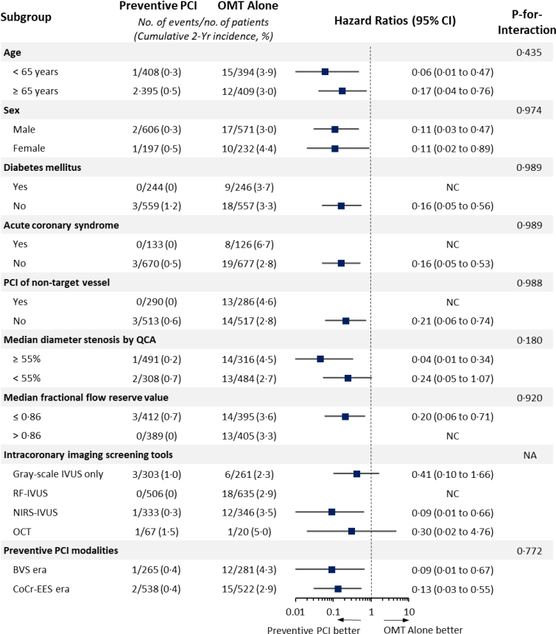
PREVENT
Subgroup Analyses
of the Primary Outcome at 2-year Follow-up

Slide 27
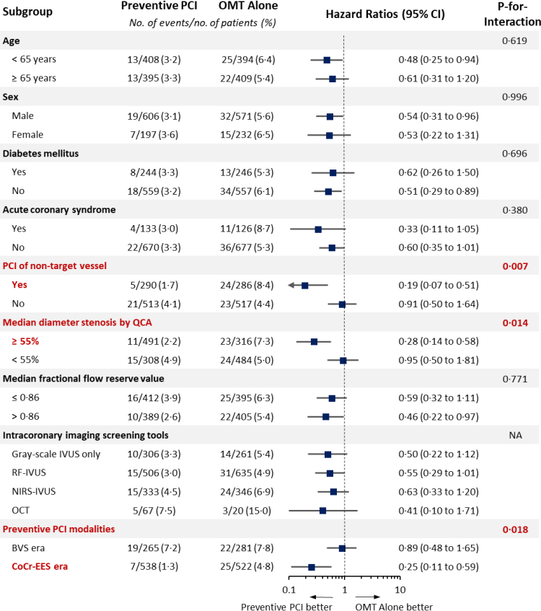
PREVENT
Subgroup Analyses
of the Primary Outcome at 7-year Follow-up

Slide 28
Study Limitations
PREVENT
The study was open-label, introducing the risks of placebo effects and ascertainment bias.
The observed rates of the primary outcome were substantially lower than expected in both groups.
The selection of imaging modality to assess plaque vulnerability was left to operator discretion.
9% in the preventive PCI group and 1% in the OMT alone group crossed over.
The study did not collect data to examine the cost-effectiveness of a preventive PCI strategy.
DAPT use was greater in the preventive PCI group.

Slide 29
Summary of Key Findings
PREVENT
The PREVENT trial is the first large-scale, randomized controlled study comparing preventive PCI plus OMT versus OMT alone for the treatment of non-flow-limiting imaging
defined vulnerable plaques.
In the PREVENT trial, preventive PCI reduced the composite risk of death from cardiac causes, target-vessel MI, ischemia-driven TVR, or hospitalization for unstable or progressive angina at 2 years.
Preventive PCI also reduced the composite patient-oriented outcome of risk of all-cause death, any MI, or any repeat revascularization.
This benefit was sustained throughout the 7-year follow-up period.

Slide 30
Conclusions
PREVENT
In the PREVENT trial, preventive PCI plus OMT resulted in a lower incidence of major adverse cardiac events compared with OMT alone in patients with non-flow-limiting vulnerable plaques
Our key findings might provide novel insights on the role of preventive PCI on non-flow-limiting high-risk vulnerable plaques in the future.

Slide 31

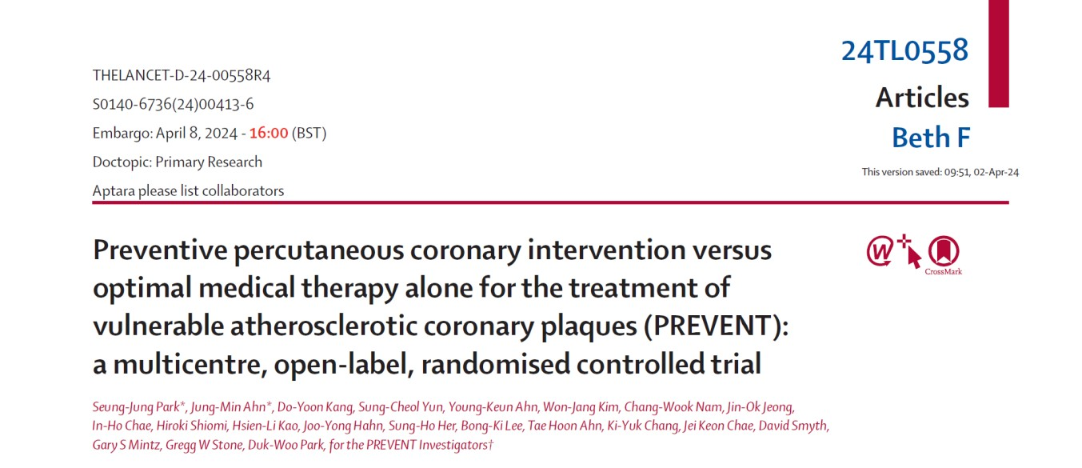
Thank You !
Further Details in the Lancet Simultaneous Publication

Slide 34
Back-up Slides

Slide 35
Anginal Status at Baseline and During Follow-up
None CCS 1 CCS 2 CCS 3 CCS 4
(%)
120%
0·1
0·8
1·0
0·3
0·5
100%
0·8
2·1
3·7
17·1
2·9
16·2
2·9
14·0
12·8
12·4
9·6
80%
24·3
21·2
60%
89·8
97·9
96·3
42·7
85·1
86·3
86·6
40%
44·3
20%
31·1
15·4
0%
PCI (N=803) OMT (N=803)
Discharge
PCI (N=762)
OMT (N=728)
PCI (N=769)
OMT (N=758)
PCI (N=620)
OMT (N=598)
Year 1
Year 2
Maximal FU

Slide 36
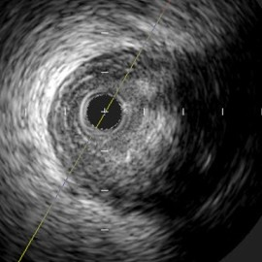
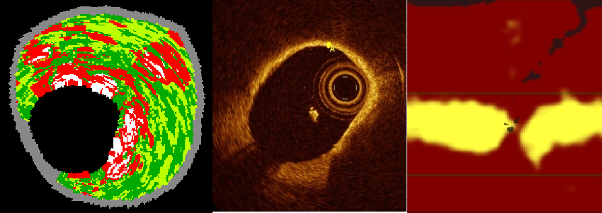
Definition of VP
PREVENT
1. MLA ≤ 4.0mm²,
Plaque burden >70%
TCFA by OCT or RF-IVUS
Lipid rich plaque on NIRS (_{max}LCBI_{4mm}>315)
MLA, minimal lumen area, TCFA (thin-cap fibroatheroma) was defined as a ≥10% confluent necrotic core with >30° abutting the lumen in 3 consecutive frames on RF-IVUS (radiofrequency intravascular ultrasonography) or a lipid plaque with arc >90° and fibrous cap thickness <65 μm on OCT (optical coherence tomograp_{m}h_{a}y_{x})L.CBI_{4mm}, maximal lipid core burden index in a 4 mm segment on NIRS (near-infrared spectroscopy).

Slide 37
Proportion of High-intensity Statin or Moderate-intensity Statin plus Ezetimibe Therapy
100
Preventive PCI
OMT Alone
90
80
70
68·7 68·3
*
*
*
63·1
60
58·8
59·8
56·6
52·7
54·6
50
40
30
20
10
0
Discharge
788 783
Year 1
742 704
Year 2
740 711
Maximal FU
578 547
No. of Observation

Slide 38
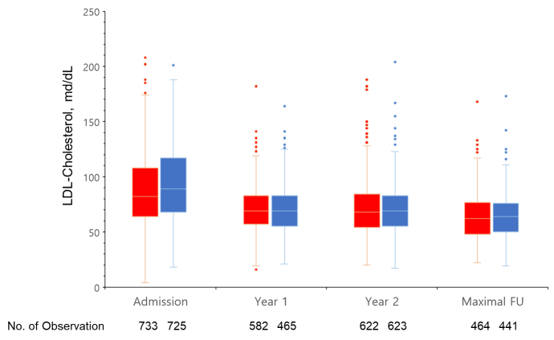
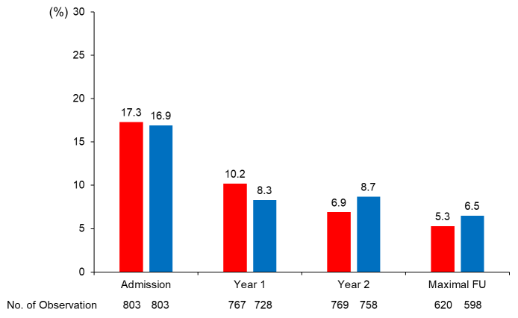
Risk Factor Control
LDL-Cholesterol
Current Smoker

Slide 39
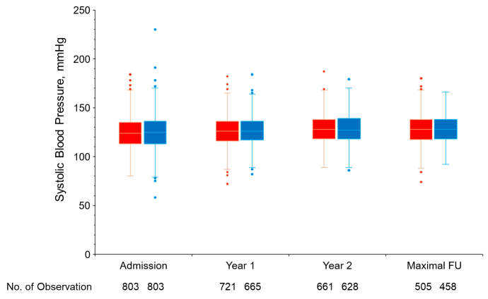
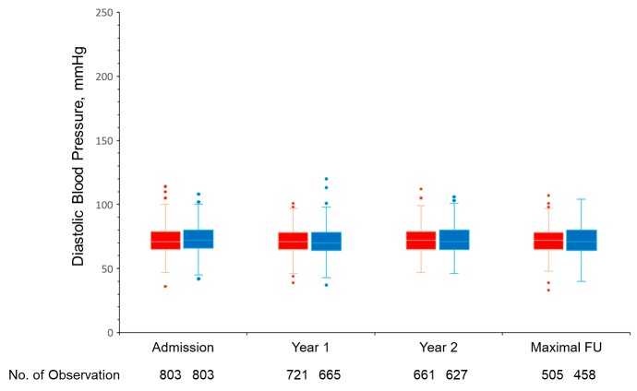
Risk Factor Control
Systolic Blood Pressure
Diastolic Blood Pressure

Slide 40
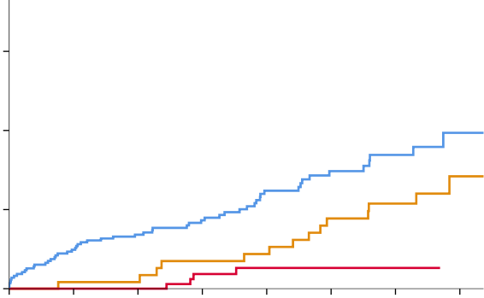
Primary Composite Outcome According to the Device Used
: As-Treated Population
15
Cumulative Incidence (%)
10
OMT alone
BVS
5
CoCr-EES
0 ₀ |  | 1 | 2 | 3 | 4 | 5 | 6 | 7
Years Since Randomization No. at Risk
OMT alone | 865 | 823 | 767 | 591 | 465 | 338 | 217 | 68
BVS | 242 | 239 | 227 | 221 | 219 | 212 | 176 | 70
Co Cr- EES | 498 | 494 | 460 | 303 | 198 | 77 | 3

Slide 41
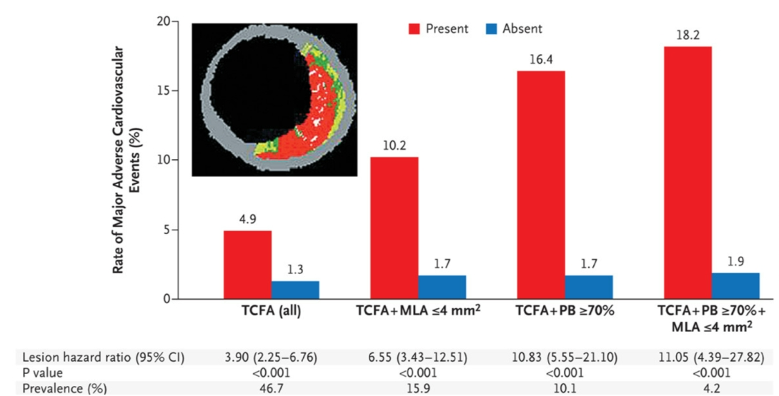
PROSPECT : (N=700, ACS, 3-Vessel Imaging after PCI)
Correlates of Non-Culprit Lesion Related Events
Rate of MACE (%)
Stone GW et al. NEJM 2011;364:226-35

Slide 42
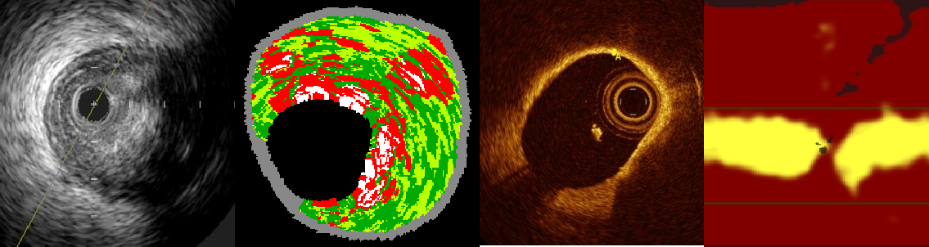
Definition of VP
PREVENT
1. MLA ≤ 4.0mm²,
Plaque burden >70%
TCFA by OCT or RF-IVUS
Lipid rich plaque on NIRS (_{max}LCBI_{4mm}>315)
MLA, minimal lumen area, TCFA (thin-cap fibroatheroma) was defined as a ≥10% confluent necrotic core with
>30° abutting the lumen in 3 consecutive frames on RF-IVUS (radiofrequency intravascular ultrasonography) or a lipid plaque with arc >90° and fibrous cap thickness <65 μm on OCT (optical coherence tomography). _{max}LCBI_{4mm}, maximal lipid core burden index in a 4 mm segment on NIRS (near-infrared spectroscopy).

Slide 43
Anatomic Characteristics: Lesion-level
 | Preventive PCI plus OMT (N=831) | OMT alone (N=831)
Number of diseased epicardial coronary arteries | N=831 | N=831
One Vessel | 327 (41%) | 330 (41%)
Two Vessel | 302 (38%) | 307 (38%)
Three Vessel | 174 (22%) | 166 (21%)

